Slide 1
On Being Eeyore in InfoSec
Or, how I learnt to hate everything & love Winnie the Pooh

Slide 2
About your heroic speaker:
{Twitter, Github}: @lojikil
Father, future-husband, neo-Stoic, applied philosopher, coder
Applied Philosophy:
Security Nihilism: the InfoSec Jun Tsuji
PLT: Antisthenes
Fatherhood: Nietzsche
Morality: Epictetus
Principal Security Consultant at nVisium
Appsec, network, light DFIR, coding, blah blah blah

Slide 3
tl;dw: a sinking symphony on why Infosec is terrible.
Formulaic understanding of security
Correctness + model + coverage.
Historicity of security
And the lack of understanding of what we already have done.
Nothing will ever get better
And then we die.
Via Winnie the Pooh (and sometimes Винни-Пух)
Notes:
This talk will have a few different ideas:

Slide 4
Outline: A gentle stroll thru the 100-acre woods.
“Security”
Process Failures
Cryptographic Infrastructure
Operating Systems
Frameworks
Network Protocols
Programming Language Theory
Thought Experiment
Notes:
This is a survey course
Security: talk about what I mean when I say “secure”
Process Failure: things that businesses and the community do to fuck things up
Cryptographic Infrastructure: the issues with X509 vs SPKI, &C.
Operating Systems: how Unix won and cost us everything
Frameworks: everything from Application containers, servlets, all the way through to app libraries
Network protocols: how things started, why we’ve left them this way, and what that implies
PLT: why programming is terrible
Thought Experiment: Seth, our director of Research, said that he thought the talk was interesting, but that it was too negative. Yeah, duh, of course. But I added a thought experiment section where I talk about some of the search I’m doing to see if we can fix these things.

Slide 5
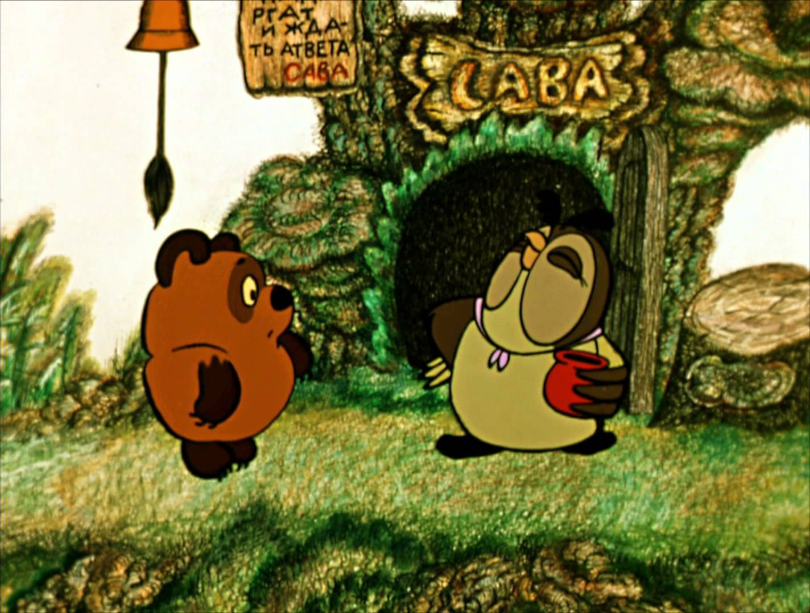
Why Winnie the Pooh again?
Themes
Notes:
My talks all have themes, you just happen to have caught Winnie the pooh
I’ll also be talking PLT & Shakespeare at some point

Slide 6
What do you mean “security?”
Notes:
I have a very specific definition of ”secure”
When I say “secure”, I don’t _mean_ “doesn’t have security vulnerabilities”
I mean that it is _correct_

Slide 7
When I say “security,” I mean…
Design +
(Denotation) +
Formalized & Verified Model +
Centralized Security Controls +
Decentralized implementation ==
“Secure”
Notes:
Design: an actual architecture, with logical components, placed together _before_ implementation, with input from all the core players
Denotation: an actual understanding of the _meaning_ behind a program/system, it’s logic, and the way it communicates
Formalized & Verified model: the model of a program & design should come first, and be checked
In fact, the program can even be extracted from this, via Coq & Isabelle
Centralized security controls: controls should be implemented at core touch points, and not scattered thorughout the code…
Decentralized Implementation: but they should be able to act on their own, without externalities. Think of certificate authorities, NTP, &C.
I want to focus on two of these, because those are more uncommon: Denotation and Formalized Modeling

Slide 8
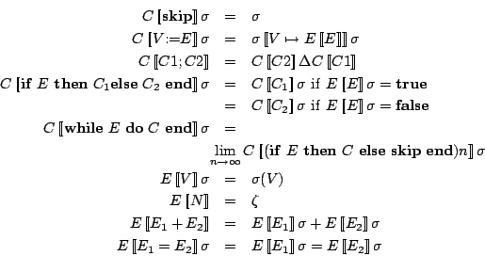
Denotation, via Denotational Semantics
Notes:
Denotational Semantics: in parens because this might be optional depending on your risk level
Describes the _structure_ of some execution, whether this is a protocol or a programming language
Formal _rules_ about what a program should and should not do under certain circumstances

Slide 9
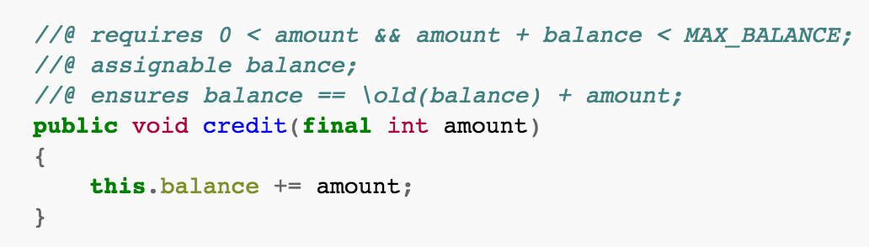
Formalized & Verified Model
Sometimes called ”contracts” (as in, design by contract)
Notes:
The model describes the way in which a specific function or method works
The program then can build up this model and ensure that things hold

Slide 10
Yes, I think you can make something “unhackable.”
It just costs:
Money (lots) in design, implementation, &c.
Time: understanding of the process, the design, formalization, verification…
Team: teams that work together, share info, don’t limit processes, are willing to burn more of both of the above...
It’s probably outside your budget.
And quite honestly your risk profile.
Notes:
Security heresy: I think you can make something unhackable
Look at XTS and the formalized nature of it’s code base

Slide 11

These will probably never happen

Slide 12
Process Failures

Slide 13
Send Piglet into the woods.
“It is hard to be brave,” said Piglet, sniffing slightly, “when you’re only a very small animal.”
Two main cost centers:
Devs: They’re not products! They’re cost!
Infosec: They’re not helping us sell! They’re blockers!
Notes:
Developers == Piglet
We send them into the woods and then expect them to provide something useful
Developers are expected to do something, something useful, and yet… we don’t equip them to do _anything_

Slide 14
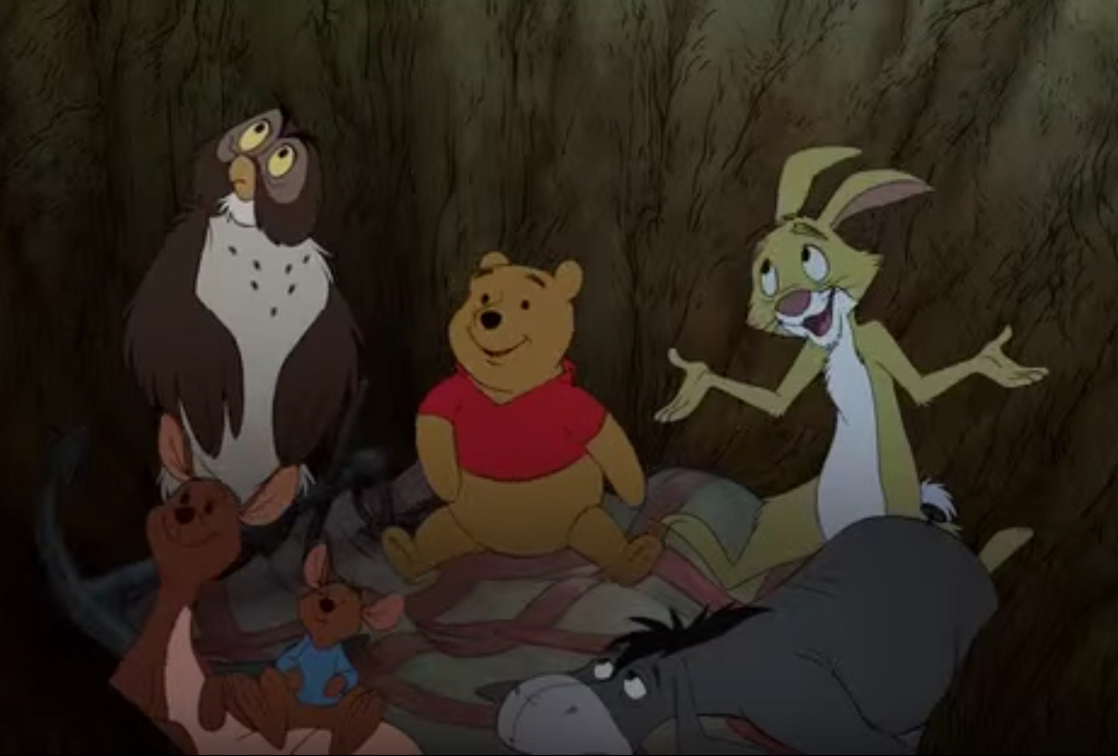
Send Piglet into the woods.
Notes:
We sit around in the pit (our app/infrastructure design) and complain about developers/admins, whilst Owl (infosec) could just fly there
Owl: Infosec
Pooh: Pooh
Rabbit: Business
Rabbit is giving developers contradictory information
Pooh is complimenting everything that is done
Owl... Can literally fucking fly there and get everything done. But doesn’t.

Slide 15
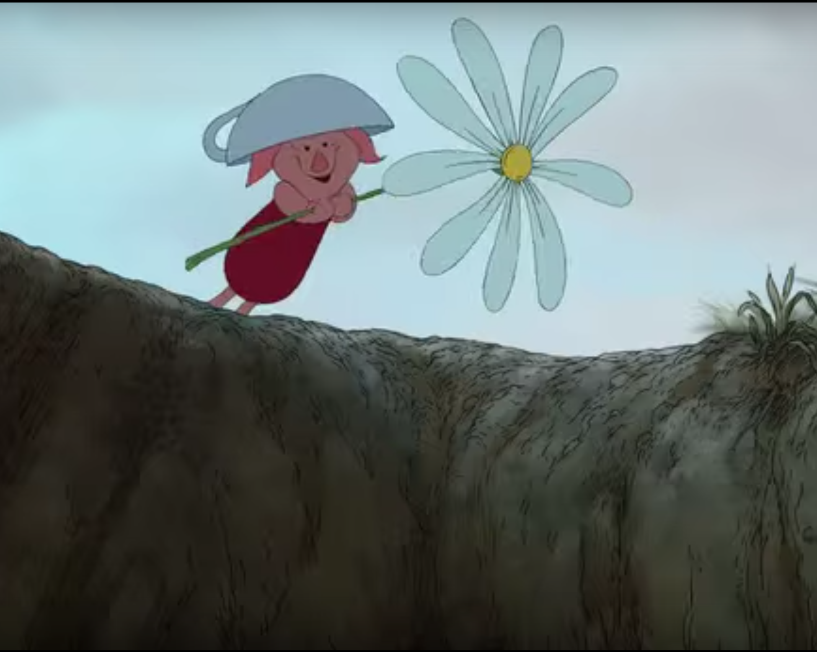
Send Piglet into the woods.
Notes:
And then when a developer comes back to us, we’re surprised they’ve done something silly

Slide 16
Send Piglet into the woods.
Businesses expect:
Devs/DevOps/Admins to do the Right Thing™
Quickly
Cheaply
Without sacrificing security
With little to no direction

Slide 17

Send Piglet into the woods
Notes:
We arm devs/admins with a little bit of knowledge and a little bit of hope, and then send them into the woods

Slide 18
Send Piglet into the woods.
What we end up with:
Whack-a-mole security
Focus on Bugzzzzzz!
Oh woops, only Red Team is sexy.
Bolt-on security
It’s very secure. We just didn’t add it to the login page.
No design
Try adding features later…

Slide 19
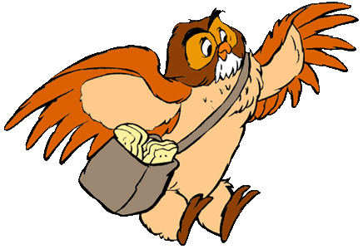
Send Piglet into the woods.
Notes:
We should just do it correctly from the start.
Design: give devs & admins direction
Empower Infosec to do the Right Thing™ (just fucking fly there)

Slide 20

Send Piglet into the woods.
Notes:
This of course, will never happen.
Infosec is just a cost center, good design is just a cost center, and our houses will all be knocked over by the much cooler Tigger.

Slide 21
Cryptographic Infrastructure

Slide 22
A History of Keys & certs:
Older: Diffie-Hellman (at least 1976), RSA (at least 1977), &c.
Needham–Schroeder protocol (via Kerberos, say at most 1987)
Replay attack, fixed in Kerberos with Timestamp
X.509
1988
Hard to parse
Hard to get right
Can’t control
SPKI
1996
Easy to Parse (Sexpressions)
Easier to apply
Can control
Notes:
Keys: we start with exchange (DH), ans practical PKI (RSA)
We say “at least” because those are the public releases; GCHQ, NSA had earlier versions
Needham-Schroeder: need to generate a session key

Slide 23
X.509
1988
X.500 support
Includes X.400 mail support!
Look at the list of X509 parsing bugs
OpenSSL ASN.1 parsing bugs
MatrixSSL ASN.1 parsing bugs
&c &c &c
Quick: explain certificate validation & chains
I’ll wait
And you trust which government entities?
Notes:
These were part of the X.500 standard. You remember that right? All those X.400 Mail directory services you have …

Slide 24

Oh, bother.
Notes:
These are _difficult_ problems. Parsing X.509, understanding the certificate chain, understanding the process… that’s not even talking about OpenSSL specific vulns, that’s just X.509 itself.
surely we can do better

Slide 25
Better! Simple Public Key Infrastructure.
Meant to address the issues:
(cert
(issuer (hash sha1 |TLCgPLFlGTzgUbcaYLW8kGTEnUk=|))
(subject (hash sha1 |Ve1L/7MqiJcj+LSa/l10fl3tuTQ=|)) ...
(not-before "1998-03-01_12:42:17")
(not-after "2012-01-01_00:00:00") )
https://people.csail.mit.edu/rivest/pubs/EFLRx98.txt
Notes:
SPKI certs are *SIMPLE*
Think of a programming language that can’t parse Sexpressions. Most have something built in
The certs themselves are pretty easy to understand
They’re easy to parse
They’re easy to implement
Note too that there is No Role for a central authority here. You can have an issuer be _anything_ you want.
https://people.csail.mit.edu/rivest/pubs/EFLRx98.txt

Slide 26
Better! Simple Public Key Infrastructure.
ACLs:
(acl
(entry
(subject
(hash sha1 |Ve1L/7MqiJcj+LSa/l10fl3tuTQ=|))
... ))
https://people.csail.mit.edu/rivest/pubs/EFLRx98.txt
Notes:
We can even encode other things within them, like ACLs!
Think about it: the same infrastructure you’re using for Certs, could also prove that you should have access to something!
https://people.csail.mit.edu/rivest/pubs/EFLRx98.txt

Slide 27

So uh… Where are they?
Notes:
Yeah, so we’ve all seen them in action… right?

Slide 28
Whither SPKI?
Pretty much dead
No $ in decentralized certificates
Used in small niches
UPNP (but uses XML!)
HP Middleware
No other main stream uses
Notes:
There’s no need for CAs, so it’s harder to

Slide 29

Oh, bother.

Slide 30
But Wait! Seth Said “Be Positive!”
We can do this!
Macaroons: http://research.google.com/pubs/pub41892.html
Cookies + Caveats + HMAC Chains
Vanadium: https://vanadium.github.io/concepts/security.html
Privileges + Delegation + Context + Groups
Notes:
WE can fix this! We’ve the technology, and the money! AMIRITE?
Google & Stanford have worked on modern alternatives
Vanadium encodes delegation from issuers to subjects, and Macaroons encode Chained HMAC with contextualizations
Macaroons are basically just fancy cookies with an encoding for HMAC and Caveats for Who/what/where/when to authorize a request.
Vanadium can contextualize a delegation

Slide 31

No. Be Eeyore.
Notes:
Who here has heard of Macaroons? Of Vanadium? Yeah, we’re not going to implement those anytime soon.

Slide 32
Operating Systems
Yes, I read the Unix Haters Manual. I wrote you a reply from my µVAX running OpenVMS.
Notes:
Let’s Talk operating systems

Slide 33
In The Beginning There Was Multics.
And God said that it was good:
But kinda pricey.
And hard to dev for.

Slide 34
Multics Security:
Think about modern security practices; now compare to multics
ACLs per file
Process Separation
Stack Separation
High-level & secure language
… in 1964

Slide 35

Yes, Perfect!

Slide 36
Ok, so now let’s make Unics.
(yes, it’s originally called Unics).
Remove most of that stuff (it’s hard & costs money).
Port it around a bunch (without a standard, that costs money).
And worry about details later…

Slide 37
Oh, bother.
We’re just now getting back to what Multics had in 1964.
Higher level languages in core
ACLs for all objects (remember, multics didn’t delineate file from memory)
Specification
True process separation
Oh and we tried.
Ix, TrustedSolaris, DOMAIN/OS…

Slide 38
We port bugs! It’s backwards compatible.
PC losering anyone?
Morris worm was a…
Notes:
PC losering is an issue wherein the PC CPU register (program counter) doesn’t know where to be set when a program was returned after task switching. Unix just assumed the user program would figure this issue out. Leads to all sorts of fun security issues.
Morris worm was a buffer over flow. We don’t have those anymore, amirite?

Slide 39
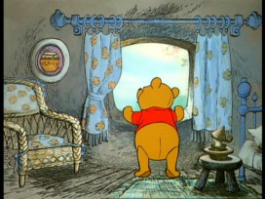
But, what about Windows?

Slide 40
But, what about Windows?
Windows (NT) background
RSX-11 (yes really) which lead to…
OpenVMS which lead to…
Windows NT which is good!
All great things!
Right?

Slide 41
Save for one little detail…
Well two:
We tried to make it easy.
We tried to make it backwards compatible (DOS, 9x, &c.).
We used C again…
szStrings, HDCs, uh...

Slide 42
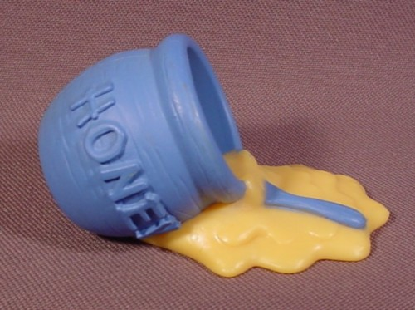
Save for one little detail…
Notes:
We went to all that hard work to reimplement QIO, ASTs, Mailboxes, &c. and then we used C and spilt all our honey!

Slide 43
But we’re getting there!
OpenMirage: Ocaml hypervisor
seL4: proofs of secure operation (with Isabelle)
Various Rust & Haskell Kernels…
Notes:
In OpenMirage we can describe our services and programs as components to a wider Ocaml operating system, and decompose our applications, networks, &C. as Ocaml code, and the separate out items based on our hypervisor. SEL4 has made great improvements to our understanding of what we can

Slide 44
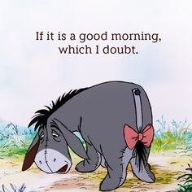
But, be Eeyore.
Notes:
I mean, really, how many of you are going to run out and rewrite your apps, SDN, &c. in a language that few even know? And then prove it correct?

Slide 45
Network Protocols

Slide 46
In the old days, stuff was _simple_.
Gopher: a selector, a query, some tabs, done.
HTTP: So you have that stuff, but instead of tabs, a ?
Also a Host header
rsh/rlogin/rexec: that stuff, but use ASCII NUL, plus execute a program.

Slide 47
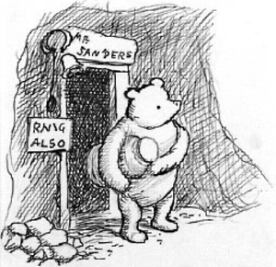
RNIG ALSO
Notes:
Our protocols were simple: we requested data, we got data, we didn’t do much with it

Slide 48
Oh, bother.
Lots of issues:
Stateless
No notion of “auth” builtin
Presentation vs Discovery vs API vs …
Data structuring, handling, vulns, &c &c &c
PLT: look at Markup as “Stringly” typed.
And the fix is...
Notes:
Stateless
can’t intelligently queue what’s next
Can’t meaningfully determine useful optimizations, because anything could be next
Auth
can’t tell who is doing what
Can’t meaningfully encrypt things without worrying about MITM, protocol issues, &c.
Data handling and structure are interesting issues as well… because Markup is structured but not typed, leading to issues
What happens if we combine typing with markup?

Slide 49
BUT, WHAT ABOUT COMPRESSION???
There is no God fix.
Replacing core infrastructure is hard .
Remember when we did that DANE/DNSSec/WebDav…
We’ll just keep killing of protocols and stuffing ‘em into HTTP.
Usenet
Mail
FTP
SSH…

Slide 50

But, be Eeyore.

Slide 51
Programming Language Theory
And thus we enter the _practical_ section of our discussion…

Slide 52
PLT History
Michigan Algorithm Decoder (MAD) // Algol 58
MAD influenced by but not Algol 58
Fortran 1956
Lisp (1958)
Cobol (1959)

Slide 53
PLT History
Fortran, Algol, MAD:
Memory management issues, overflows, computed jumps (logic errors)
Lisp:
Garbage collection => heap exhaustion (DoS)
COBOL
FROM USER ACCEPT DATA GIVING LOGIC-ERROR

Slide 54
In the beginning was the overflow…
… we just never fixed it.
We’ve known about it since _at least_ 1972 as a studied issue.
low-level & old vulns continue to plague us.
PLT decisions impact actual security
Reification of implementation choice can be an interesting space
“Android Compiler Fingerprinting” http://hitcon.org/2016/CMT/slide/day1-r0-e-1.pdf

Slide 55
Newer _must_ be better!
A partial view of the C family.
C – 1972 (earlier if you consider B)
C++ – 1983
Objective C – 1984
I mean, newer is better, right?
Java – 1995
Haskell – 1990 (older if you consider Gofer, KRC, Miranda…)
OCaml – 1996, 1985 if you consider Caml
Standard ML – 1990

Slide 56
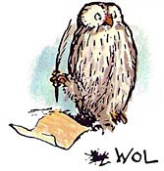
Not really; we keep on writing…
Notes:
I mean, clearly not right? We keep on writing languages, and run times, and new compilers, and fixes, and…

Slide 57
Example:
char foo[128] = {0};
for(int idx = 0; idx <= 128; idx++) {
foo[idx] = ‘A’ + (idx % 26);
}
Notes:
Our languages allow disconnects from things like array sizes

Slide 58
Example:
That’s why we have fancy new languages to help!
let mut f : Vec<char> = Vec::with_capacity(128);
for x in 0 .. 128 {
f[x] = ((65 + (x % 26)) as u8) as char
}
println!("{}", f[0])}

Slide 59
Example:
… Right?
thread '<main>' panicked at 'index out of bounds: the len is 0 but the index is 0', src/libcollections/vec.rs:1187
note: Run with `RUST_BACKTRACE=1` for a backtrace.

Slide 60

Oh, bother.

Slide 61
Quick fixes
let mut f : Vec<char> = vec![' '; 128];
for x in &vec {
// stuff
}
// or
for (idx, val) in vec.iter().enumerate() {
// stuff
}

Slide 62
Tying this all together…
PLT ties all of the above together.
Formal Verification
Modeling
Centralized Controls
Denotation
Can even tie-up your infrastructure
Consider: what if you could model your SDN & cloud from Nix?
But, it’s still easy to get wrong.
https://mitls.org/pages/attacks

Slide 63
Getting better at this:
Better languages
Rust (yes, I just picked on Rust too, but still), Whiley (http://whiley.org/), ATS (http://www.ats-lang.org/), Ocaml, Haskell
Better Code
Isabelle, Coq := Denotations & Formal semantics => Code
Better Compilers
CompCert :=
Better Tooling
PVS Studio (Static Analysis), Frama-C (AI), &c.

Slide 64
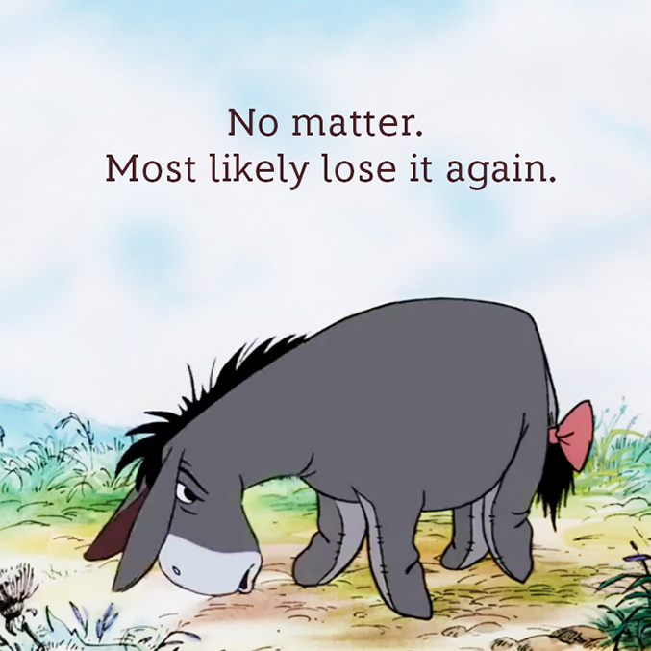
But, be Eeyore.

Slide 65
Gedankenexperiment

Slide 66

Uh, what?

Slide 67
carML
https://github.com/lojikil/carML
Combine Hoare Logic with Functional code with nicer syntax
Ideas from Rust & others as well
Based off of lessons learnt from Digamma
https://github.com/lojikil/digamma
https://github.com/lojikil/hydra-testing
Decidedly ML-based
But more Yeti, less Standard ML/Ocaml

Slide 68
carML
@document-fetch index : int user : UserType => Document
@/require document-fetch (>= index 0)
def document-fetch index user = match user with
case AdminUser, (<= index 100) = …
case NormalUser, (>= index 100) = ...
...
end

Slide 69
carML
About 75% done with the parsing
Have a prototypical compiler to keep me honest
Catching up with Digamma/Typhon soon

Slide 70
Whistlepig
An expansion of an older protocol
Bits of 9p (from Plan9) and Gopher (remember gopher?)
With some QML thrown in
Keys and Certs from the start
https://gist.github.com/lojikil/f75711261b64eea660833f703f6e7acd

Slide 71
Outro

Slide 72
There is no point
Nothing presented here will save you
You are still an island of pure meaning swimming in a sea of values that are inaccessible to other islands.
We all die
It’s like Ecclesiastes 1:2-11 bb
Also your security is probably still bad
Even if you do these things

Slide 73
Questions?

